Slide 1
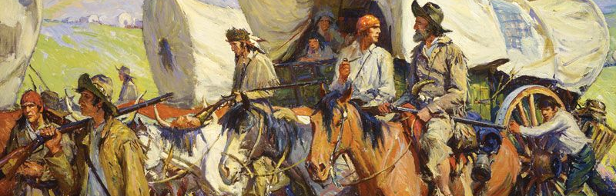
Wagon Vs Wild
Developer: Connor Smith
A Text Based Adventure Game Inspired By Oregon Trail!
URL: https://github.com/ksu-is/Wagon-vs-Wild

